Slide 1

Organizational Culture and Environment

Slide 2
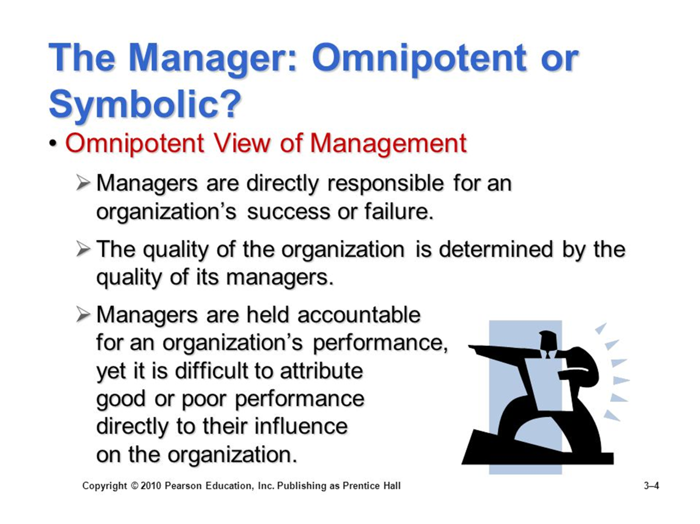

Slide 3
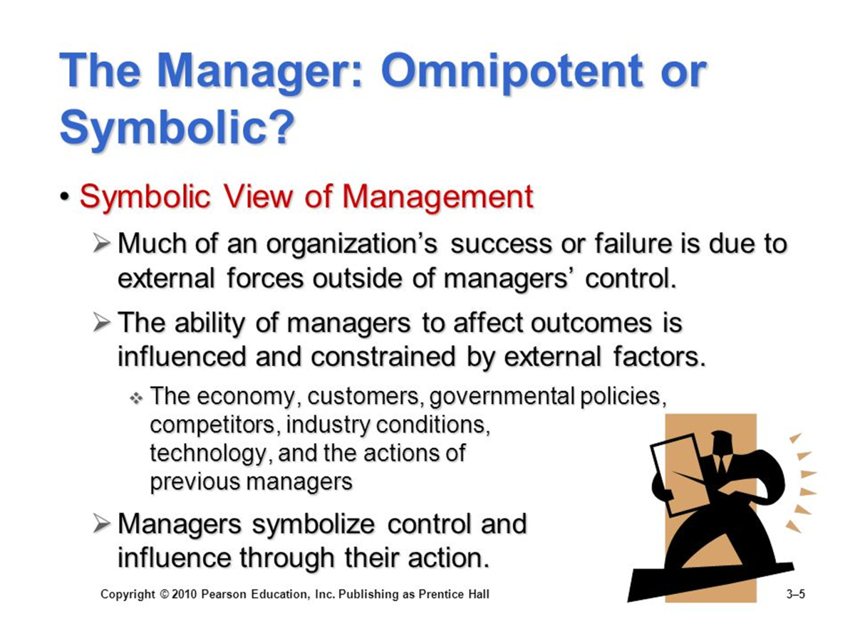

Slide 4
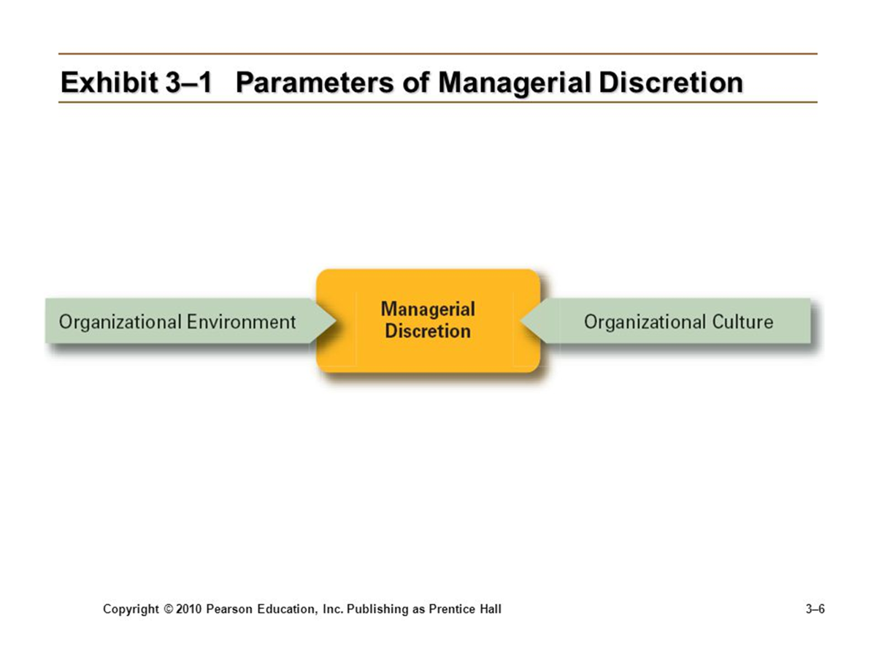
Reality Suggests a Synthesis

Slide 5
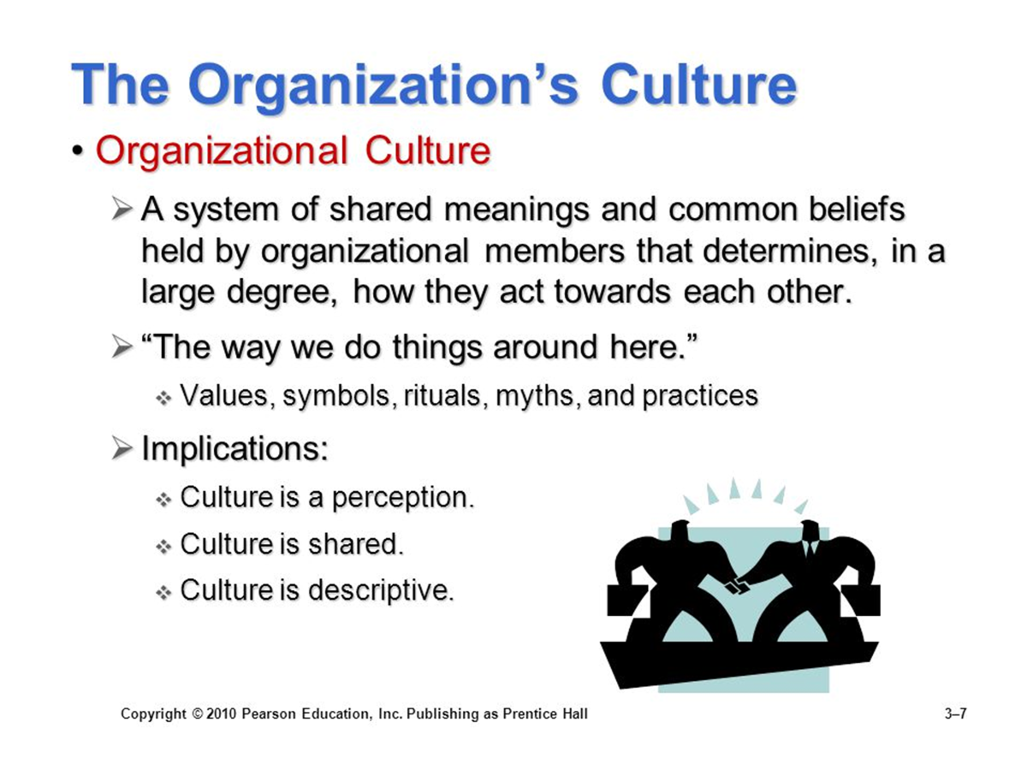

Slide 6
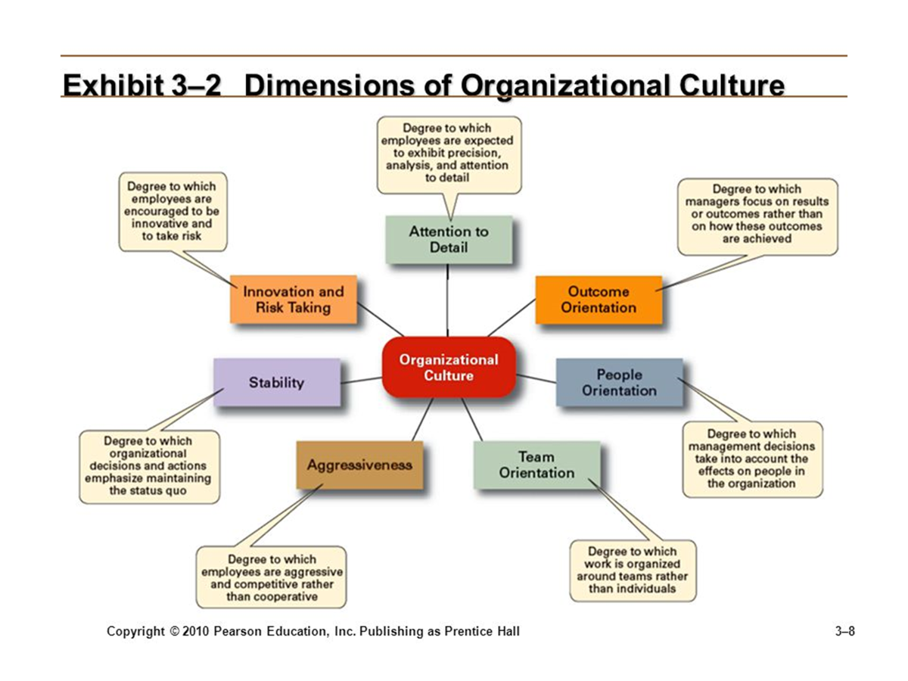

Slide 7
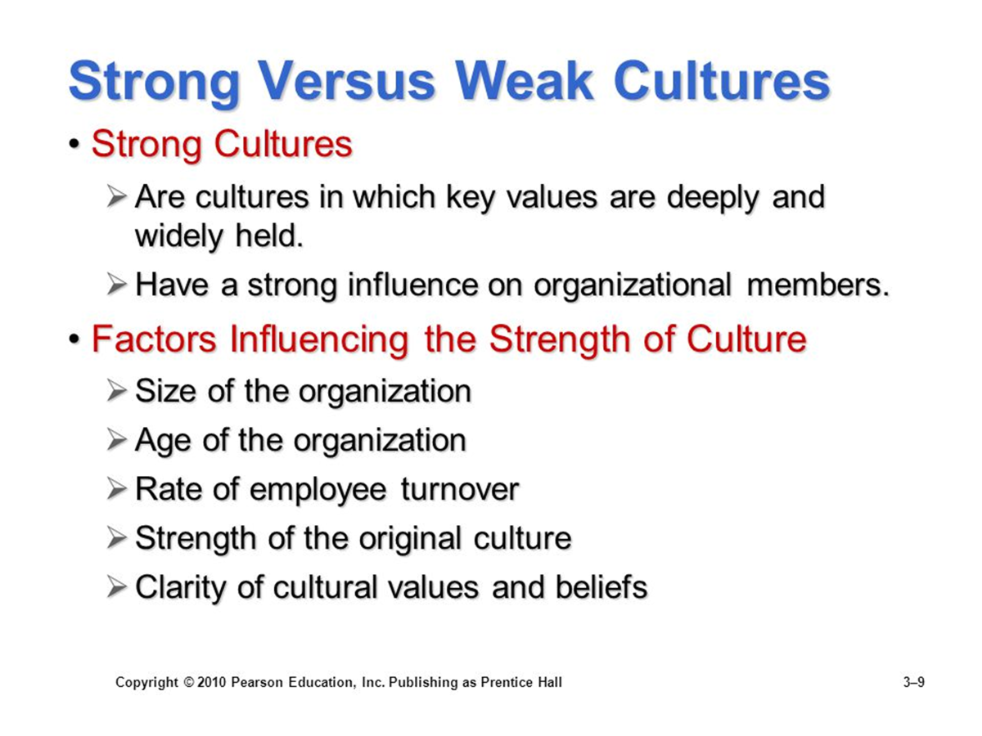

Slide 8
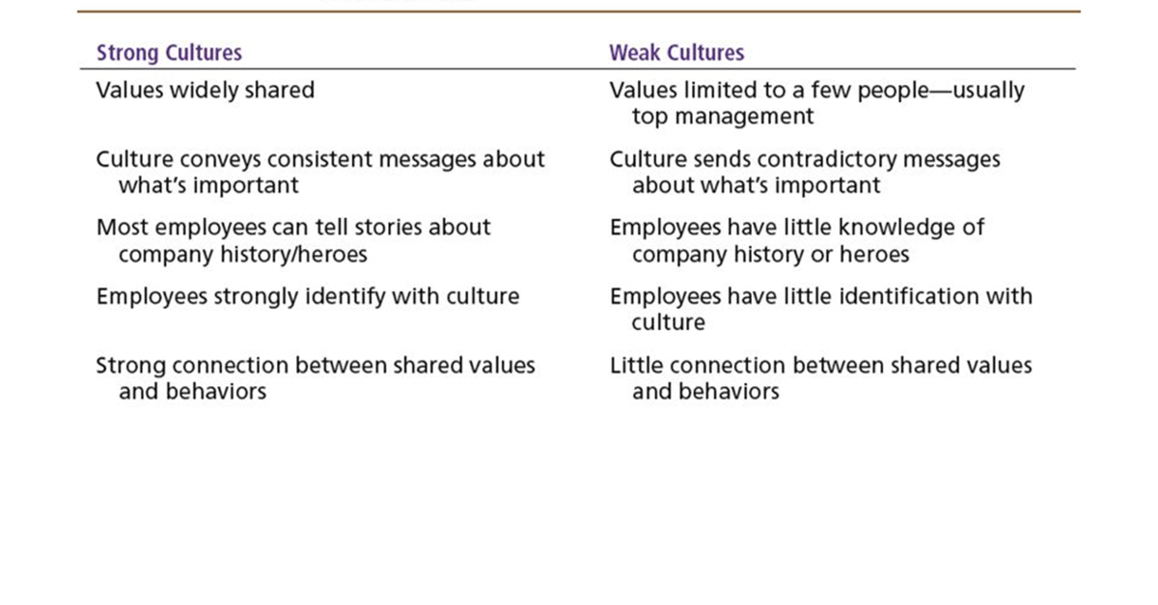
Strong versus weak cultures

Slide 9
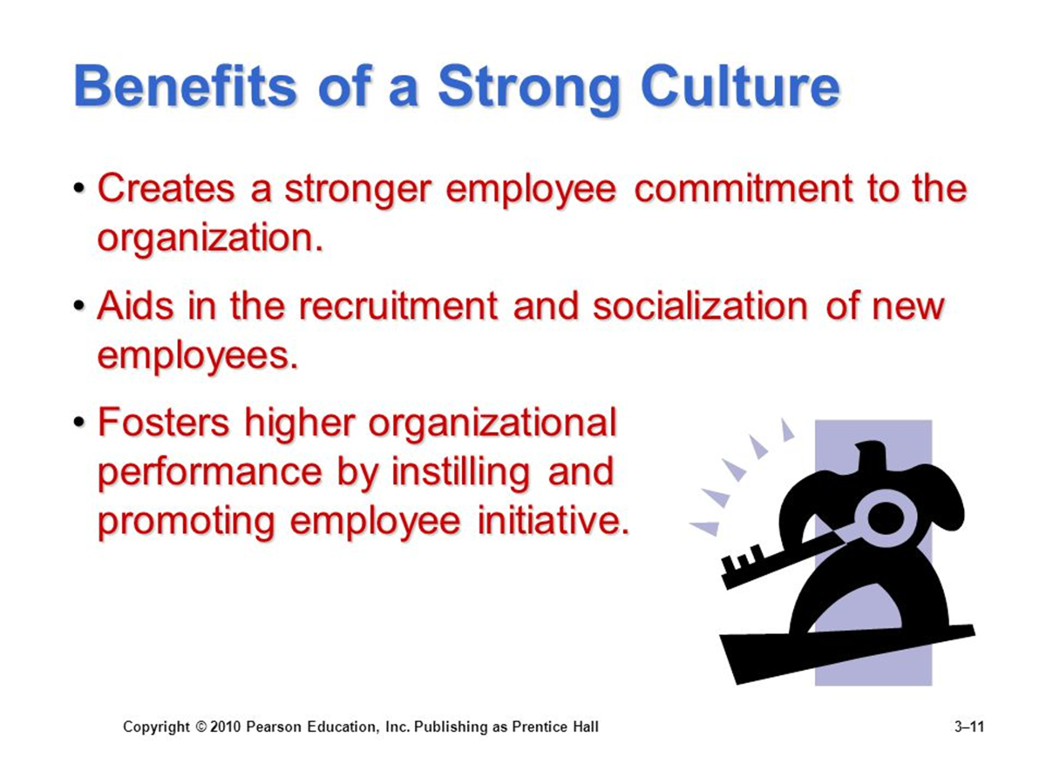

Slide 10
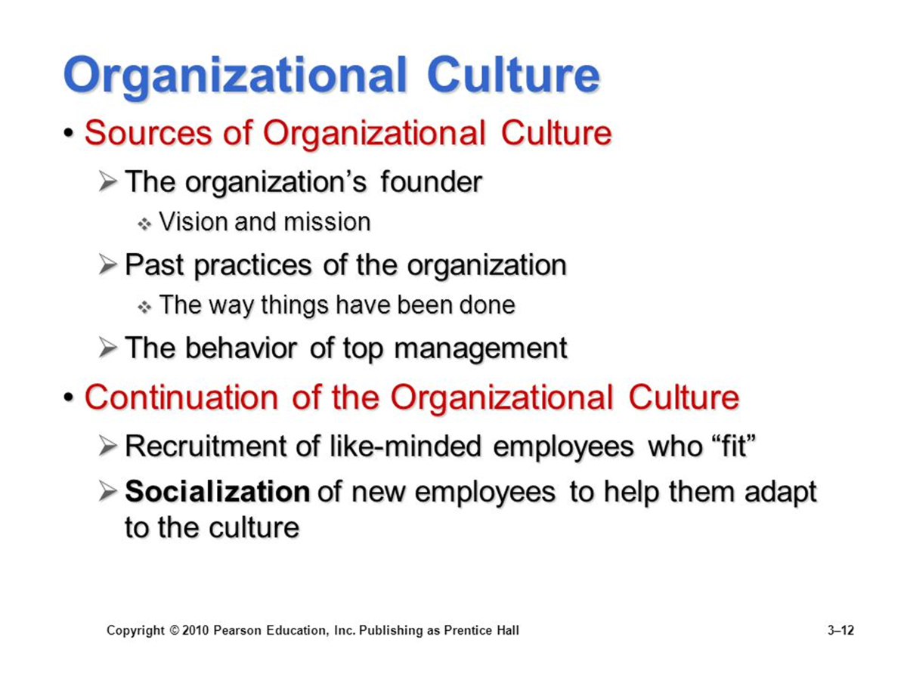

Slide 11
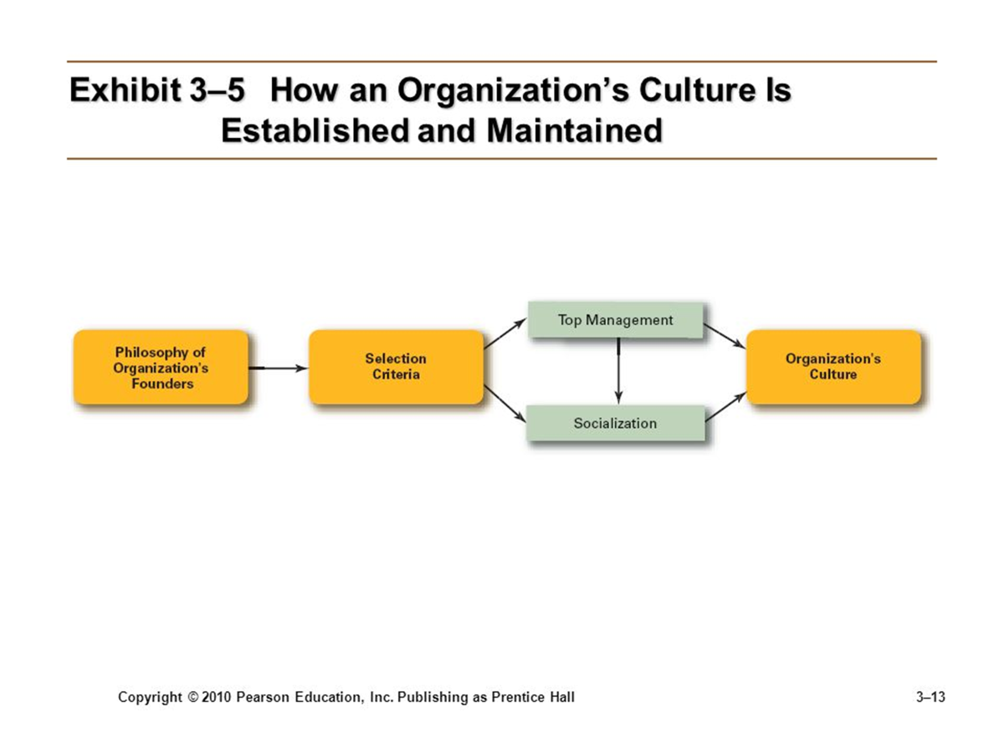

Slide 12
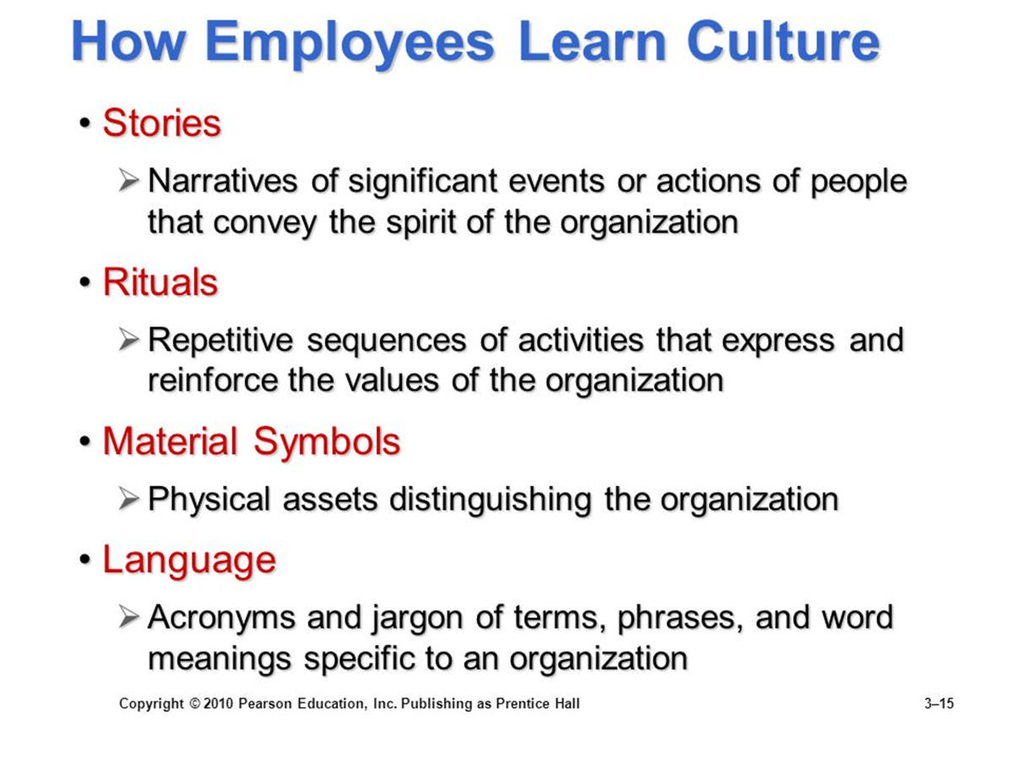

Slide 13
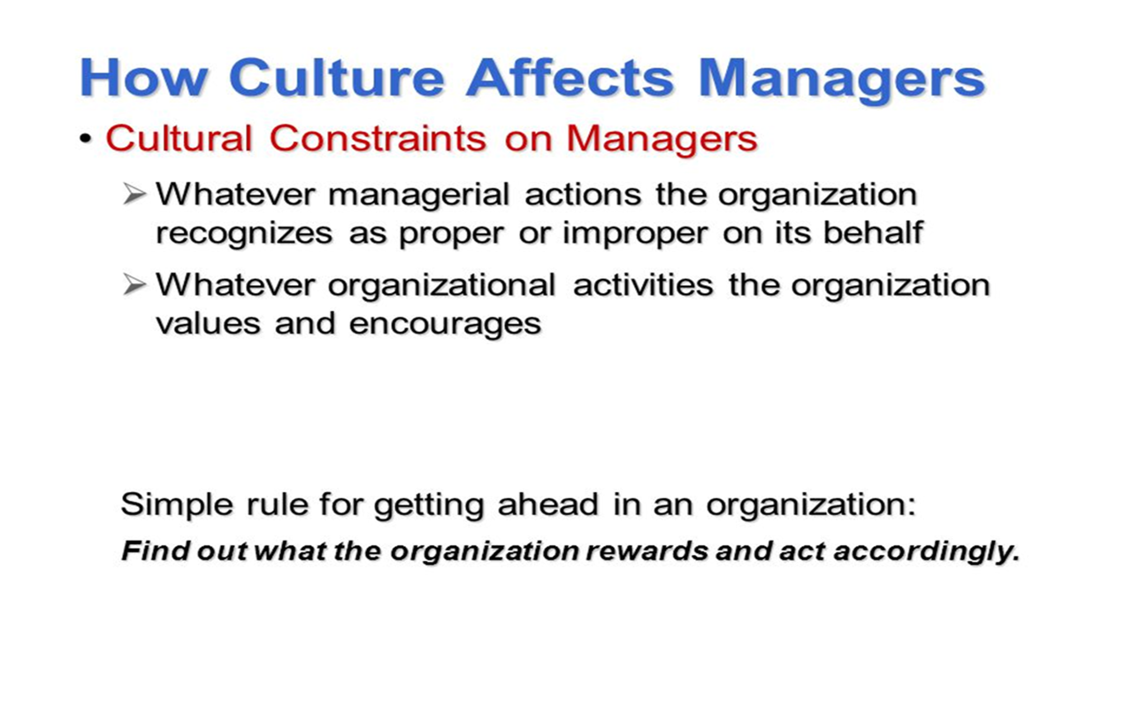

Slide 14
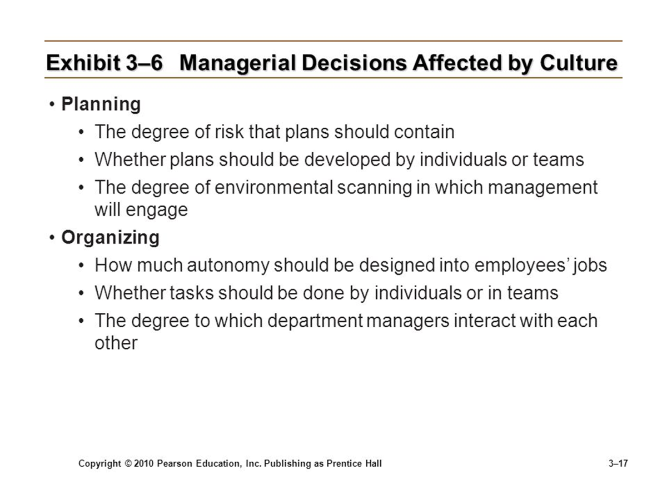

Slide 15
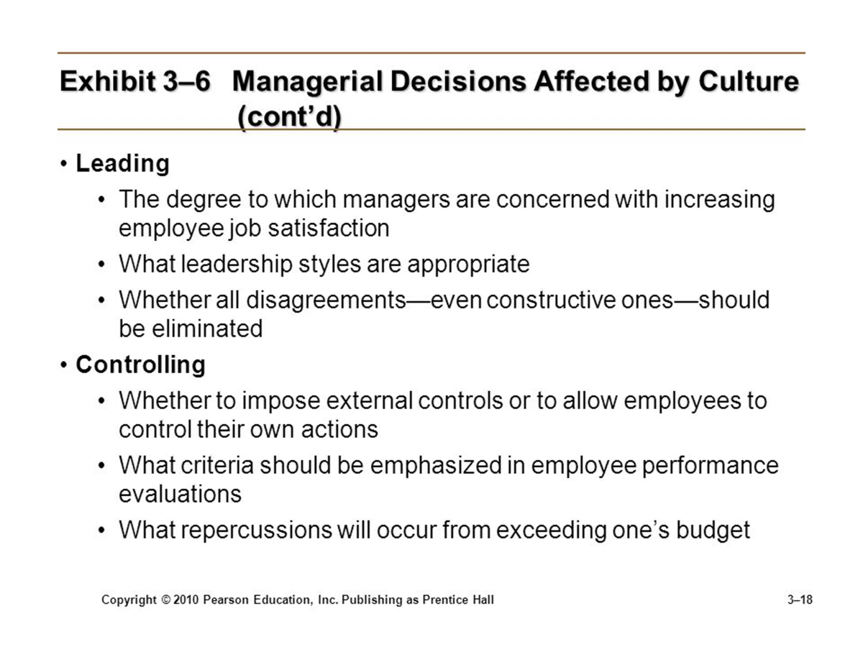

Slide 16
Current Organizational Culture Issues
Creating an Ethical Culture
An organizational culture most likely to shape high ethical standards is one that is:
High in risk tolerance
Low to moderate aggressiveness
Focus on means as well as outcomes

Slide 17
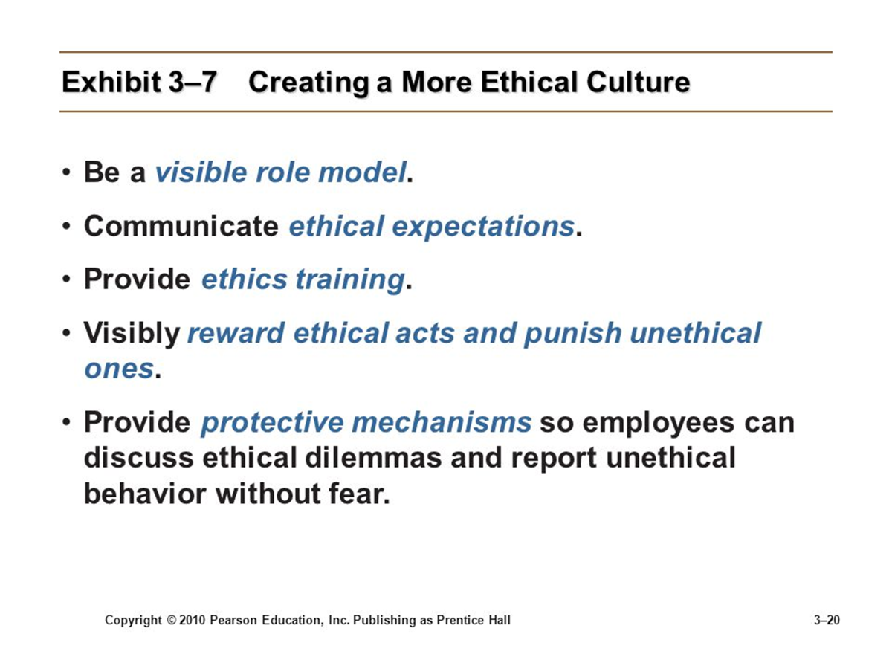

Slide 18
Current Organizational Culture Issues
Creating an innovative culture
Challenge and involvement
Freedom
Trust and openness
Idea time
Playfulness/humor
Conflict resolution
Debates
Risk taking

Slide 19
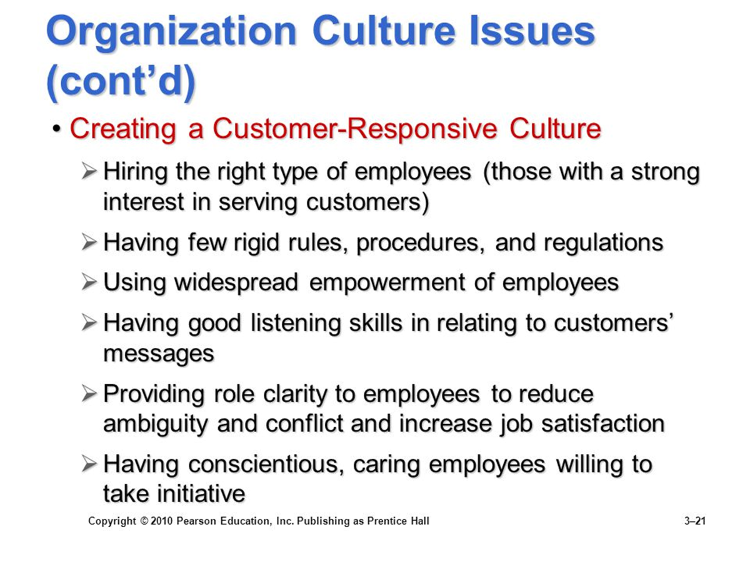

Slide 20
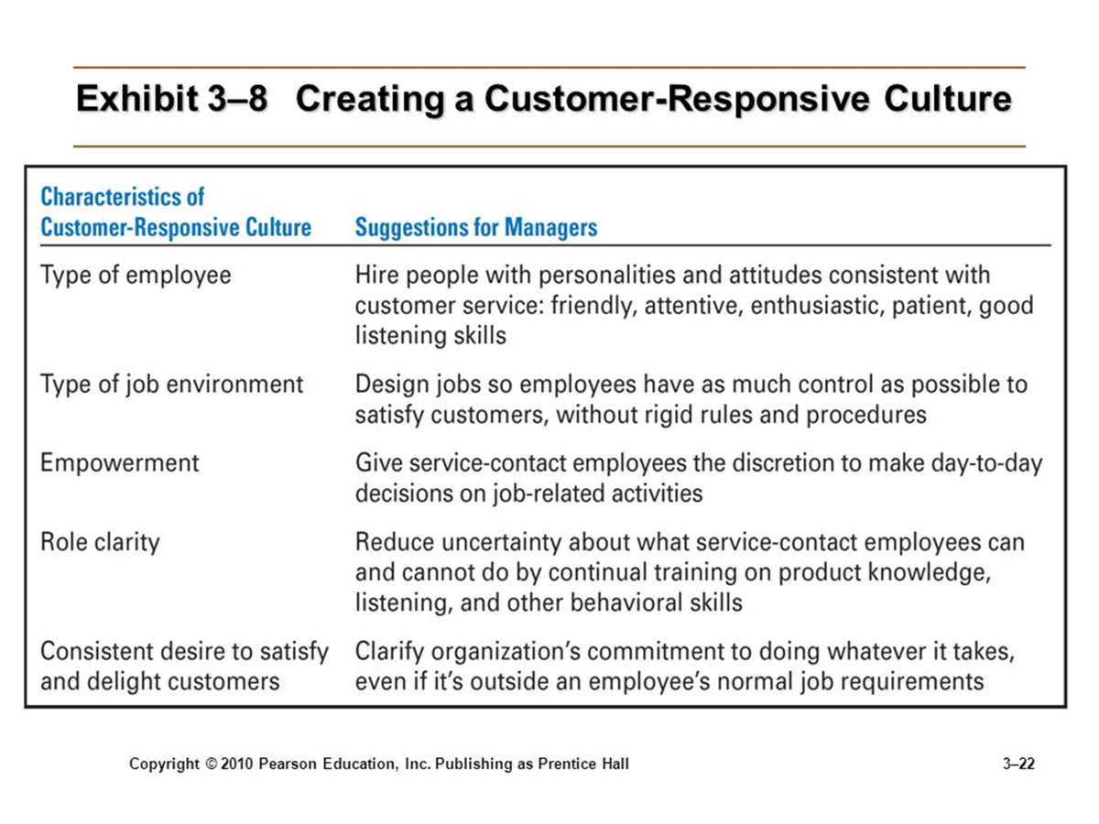

Slide 21
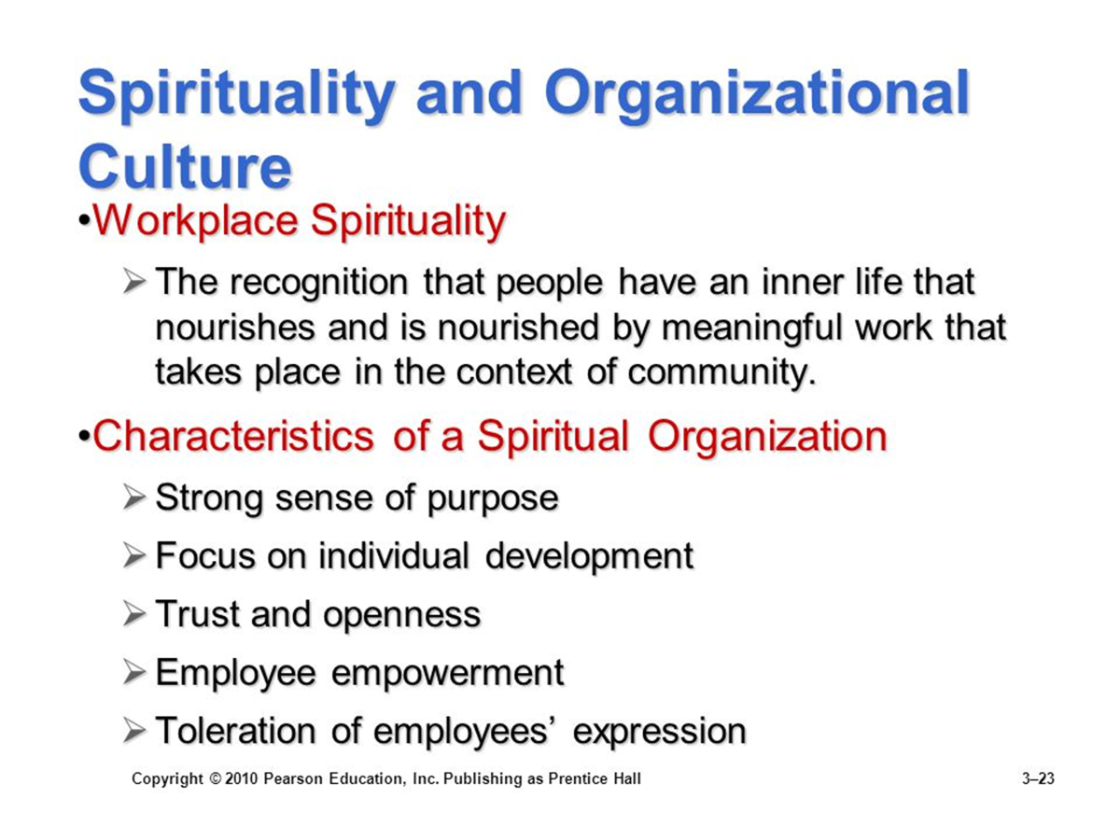

Slide 22
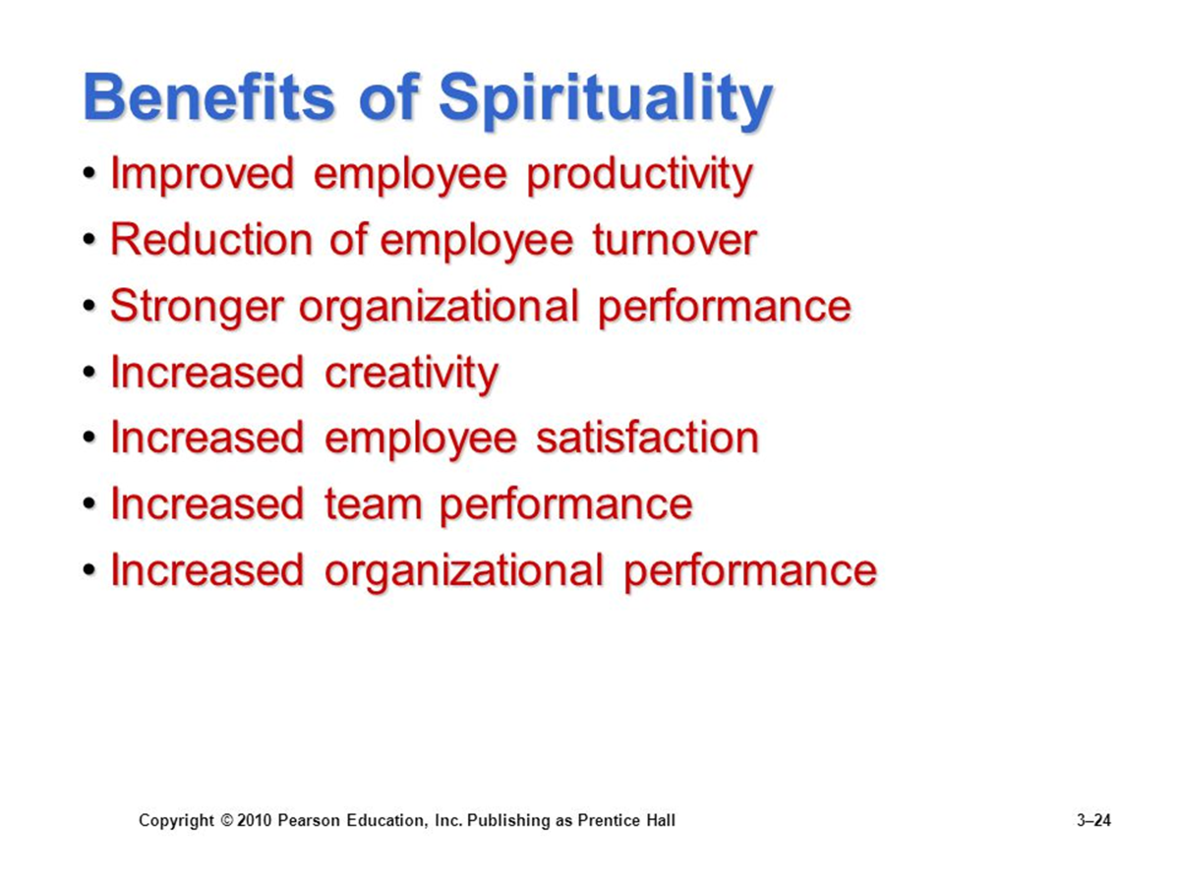

Slide 23
The Environment
As an organization is an open system, it interacts with its environment as it takes in inputs and distributes outputs.
Defining the external environment
It refers to the factors and forces outside the organization that affect the organization’s performance.
It includes two components:
The specific environment
The external environment

Slide 24
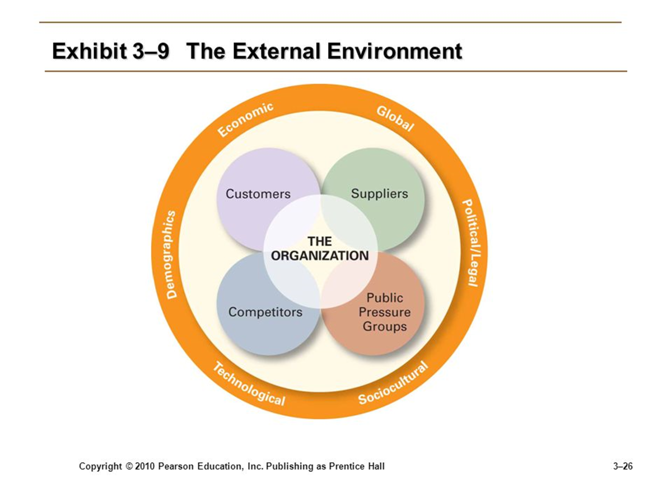

Slide 25
The External Environment
The Specific Environment
The environment which includes external forces that directly impact managers’ decisions and actions and are directly relevant to the achievement of the organization’s goals.
The forces that make up specific environment
Customers
Suppliers
Competitors
Pressure groups

Slide 26
The External Environment
The General Environment
The environment that includes the broad economic, political/legal, sociocultural, demographic, technological and global conditions that affect an organization.
The forces that make up general environment
Economic conditions
Political/legal conditions
Sociocultural conditions
Demographic conditions
Technological conditions
Global conditions

Slide 27
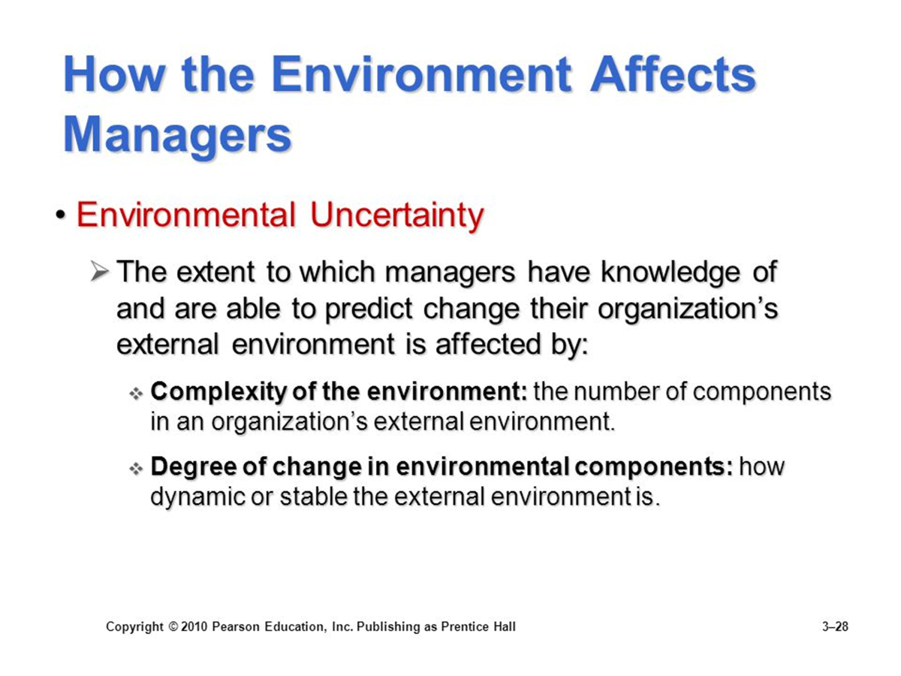

Slide 28
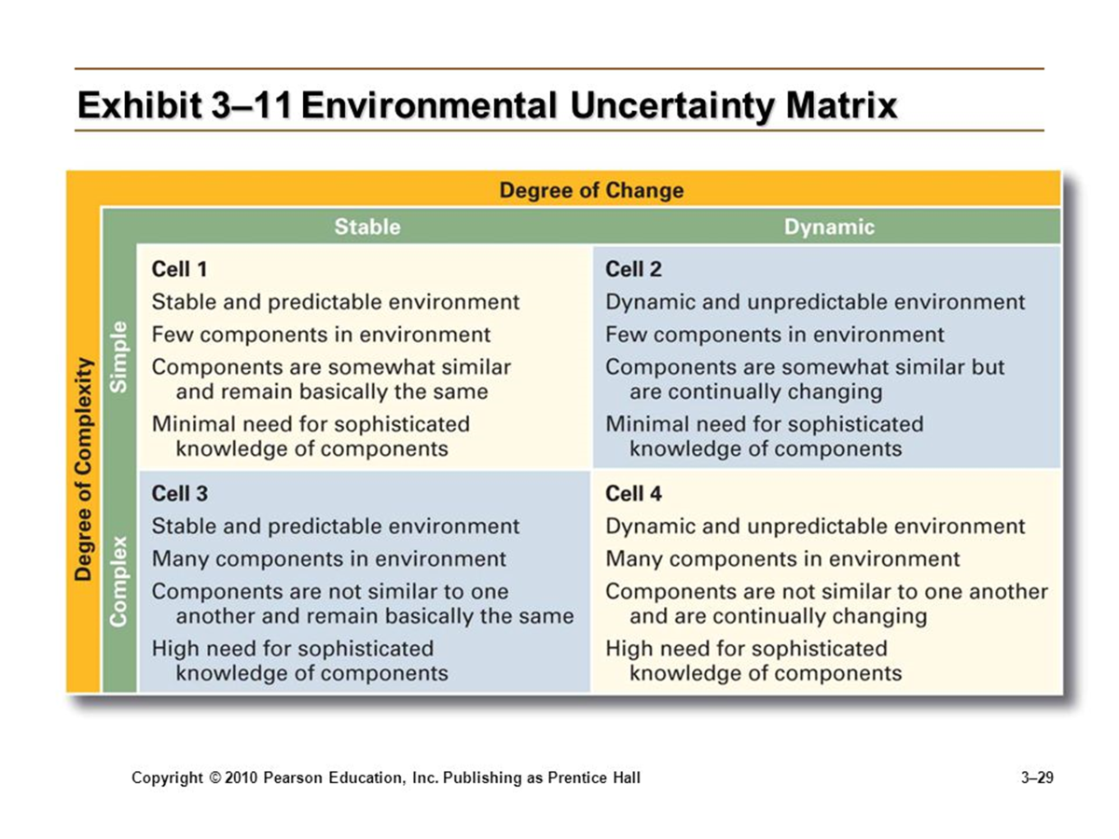

Slide 29
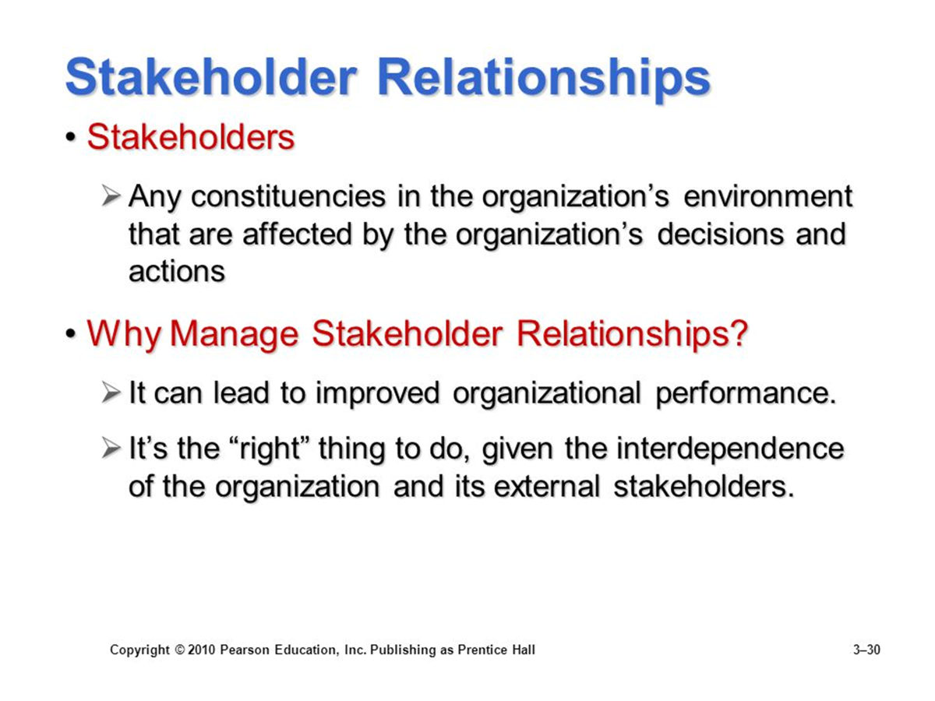

Slide 30
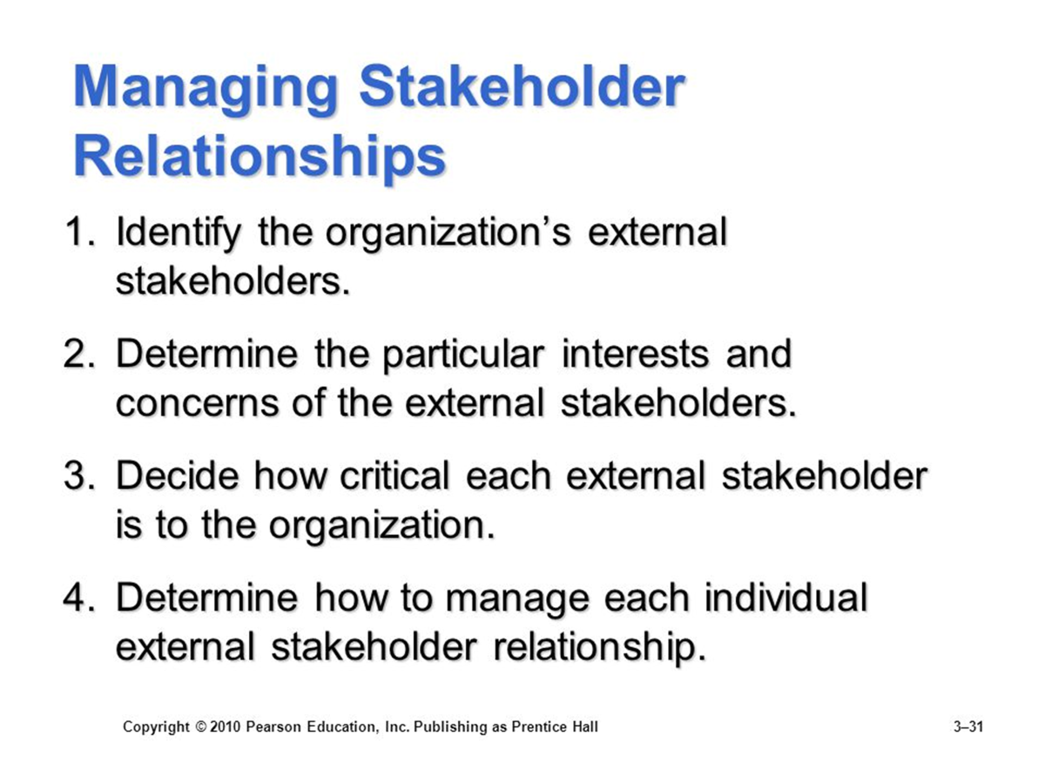

Slide 31
